Slide 1


WELCOME BACK TO
DELIVERY, FOLLOW UP & RETENTION
MODULE 5
Fatma Alsagaf – Learning & Development Manager
Notes:
On flipchart – Pre-delivery expectations, Post delivery expectations, delivery day expectations.

Slide 2











HOUSEKEEPING
Notes:
Housekeeping Items for trainer to share with the group.
Timings – 09:30-16:00
Toilets – AATC toilet location based on training room
Fire Exit – Highlight Location and fire assembly point
No Smoking Building – Highlight smoking area
Refreshments to be provided (Canteen area)
Lunch to be provided (Canteen area)
Questions – We encourage and welcome questions to get the most from the course
Mobile Phones/Devices – Are to be switched on silent/off and stored in your bags or pockets to avoid distraction.

Slide 3

YOUR SALES GROWTH JOURNEY SO FAR…
First Gear - Sales Induction & Probation
IMI Sales Process Module 1
IMI Sales Process Module 2
Product eLearning
IMI Sales Process Module 3 (Half day)
On the job training
Advanced Customer Communications
Coaching 1-2-1’s
IMI Sales Accreditation Assessment (In-Branch)
IMI Sales Accreditation Awards Ceremony

Slide 4
AGENDA
Welcome & Introduce
Critical elements to great delivery
Customer Expectations
Delivery Process Steps
Post Delivery & Follow Up
Retention & Loyalty Techniques
Assessment Preparation
Notes:
First part is about delivery. The whole process is very important but there are very imp section the initial the first impression is the only impression. 2nd section. 3rd section is delivery: should stay in their mind for the future, very memorable moment. We will then look at what can we do to main the relationship in the longterm, a lot more friendly. Assessment Preparation, what is the assessment will be about. Hands up if you have delivered cars in the last 2 days? You should be sleek and upto speed with delivery..

Slide 5
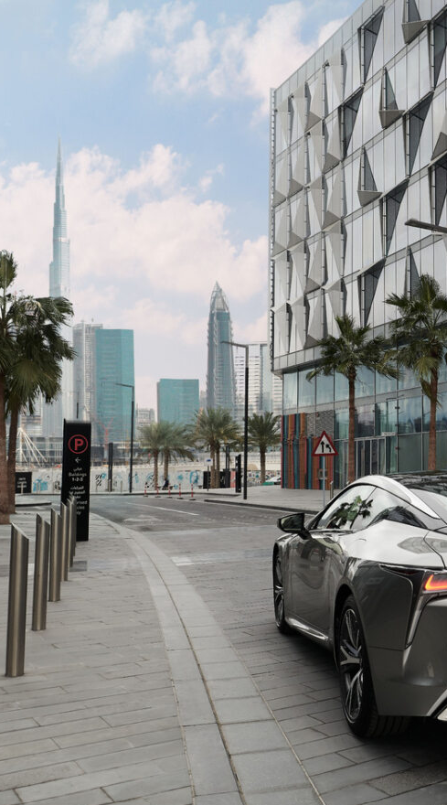
COURSE AIMS & OBJECTIVES
What are your course objectives?
What are our course objectives
Define the importance of exceptional deliveries
Know our customers delivery expectations
Demonstrate the steps to exceed delivery expectations
Identify how to create a memorable delivery experience
Demonstrate how to effectively follow up post-delivery
Know how to nurture, retain and generate customer loyalty
Notes:
Think about leading up to today, after you delivered, reflect on how you have handled the delivery, and what could you do better, whether you were stressed. Reflect with yourselves and write down, what you would like to learn from today's session. What do you want to increase in your skill.
Conference to change the operation process, we know the challenges and we know the solutions, what can we do . Business improvement planning team, therapy session, we need to improve our delivery process.
These are our objectives.
1.Better than garhash etc
3. You should know the process
4 how can I go over above the standard. Some things are standard: like ribbon, cloth. How can we go above standard.
5. Relationship that is more genuine way, not pressure sales technique way

Slide 6
MODULE RECAP
Prospecting & Welcome
Qualification
Presentation & Demonstration
Negotiation & Closing
Great Deliveries
Follow Up & Retention
What did you learn in our previous module?
The importance of the present and demo step for the sales process
How to present the vehicle to a customer using:
5-steps walkaround
SPEECIT
FFBA
How to perform and exceptional test drive
How mindsets can impact negotiation
Trial & Final Closing
Notes:
Who can remember what techniques we have learnt , where do we start and where do we finish.
What things we need talk about during the walkaround?
What does the product guide help you with?
Few things we discussed in negotiation, what are the different outcomes in it? When we negotiate what is the customer expecting, and what is my expectation. can we agree on something.
What we want you to imagine you have done all that, and after few days the customer has come back for a delivery

Slide 7

CRITICAL ELEMENTS TO GREAT DELIVERY
At this stage, the customer is ready to receive their new purchased vehicle.
All processes are finished, and no further negotiation required
Now it is the time to add the cherry on top of the cake and carry out a great delivery because of the following reasons:
Last impression is the first thing your customers will remember
Is a huge determiner of satisfaction
Starts off ownership experience
Starts off service relationship
Important factor in satisfaction surveys and social media review
Sets up: referrals, repeat business and loyalty
Notes:
1. we leave with a good impression. Maybe the person is there is influential
2. Best NPS score, best reputation as a professional, you have to do good deliveries, but these final moments is what the customer will remember. If the last thing they remember is not positive it is likely that their satistaction is not positive and if the last …
3. If you handover and introduced them to the service team, there service
Let us get you on your feet.

Slide 8
CUSTOMER EXPECTATIONS
Notes:
Think like a customer, don’t think like a sales person.
On flipchart – Pre-delivery expectations, Post delivery expectations, delivery day expectations.

Slide 9



ACTIVITY : WHAT DO CUSTOMERS EXPECT?
Using the Flipcharts in the room each group to create a list of customer expectations split into the following sections;
Pre-Delivery Expectations
Delivery Day Expectations
Post-Delivery Expectations
x3 Groups – evenly split the entire group
10 minutes – 5 mins post discussion
Notes:
READ CAREFULLY
DO
Choose sample of the participants (6 Max)
Ask the rest of the classroom to be the judge for and write down their comments
After finishing the activity with all the chosen participants (max 6), ask the rest of the class to share their comments
Make sure that the participant who will be delivering the vehicle to you fulfill these steps
Recap
Recap of the Invoice (Contract)
Configuration of the car (Color, interior, trim, accessories, service contracts, etc)
Financial services if any
Full detail of costs (registration, tax, insurance, etc)
Pre-Delivery
Explain the customer all the steps that happened before delivery to build value
PDI steps
Pre-check list by SC
Car is clean
Preset of all features and setting of the car
Car is in delivery area
Explain the warranty coverage
Explain the service & maintenance patterns
Delivery
Provide a warm welcome to the customer and congratulate them for their purchase
Provide an overview on the delivery process
Provide an estimate on how long the delivery process will be
Review key features of the vehicle with the customer using the vehicle based on his interest (SUVPS)
Ask the customer if he wants to go through all the other features in the car
Pair bluetooth phone
Review key features of the vehicle with the customer using Owner Support+
Cover Exterior
Cover interior
Review the warranty Booklet
Review Owner manual
Sign the delivery Certificate
Explain the procedure for service scheduling and schedule first service appointment
Thank the customer for their business
Set a follow up appointment

Slide 10
CRITICAL ELEMENTS TO GREAT DELIVERY

Slide 11

CUSTOMER EXPECTATIONS
Having the vehicle arrive in sparkling condition is a fundamental expectation
Checklists heighten image of professionalism and make them feel their time is respected
Being patient with any questions and letting them take their time can improve the experience
Service Department tour helps transition to the next phase
Notes:
SAY:
Al-Futtaim Automotive did some research recently on what customers expect for the delivery
As you might guess, having the vehicle arrive in sparkling condition is a fundamental expectation
Using a checklist heightens the image of professionalism and makes customers feel their time is respected
Being patient with any questions and letting them take their time can improve the experience
And, providing a tour of the Service Department helps transition the buyer to the next phase of the dealer-customer relationship
ASK:
Anything surprising to you?
Take answers and look for: Use of a checklist heightens the experience
TRANSITION:
Let’s explore that idea of checklists a little more. We have a tool for you that may meet this expectation perfectly

Slide 12
DELIVERY PROCESS STEPS
Notes:
Set expectations. 1 hour, even if you will finish in 30mins

Slide 13
ACTIVITY : WALKING WALL – BEST PRACTICE
Add the best practice actions we should demonstrate during each stage of the vehicle delivery. Groups should rotate between all 3 stages spending 5 minutes at each stage. Each group to start at one of the three papers on the wall (pre, during or post-delivery).
x3 Groups – evenly split the entire group
10 minutes – 10 minutes discussion of each step
Notes:
READ CAREFULLY
DO
Choose sample of the participants (6 Max)
Ask the rest of the classroom to be the judge for and write down their comments
After finishing the activity with all the chosen participants (max 6), ask the rest of the class to share their comments
Make sure that the participant who will be delivering the vehicle to you fulfill these steps
Recap
Recap of the Invoice (Contract)
Configuration of the car (Color, interior, trim, accessories, service contracts, etc)
Financial services if any
Full detail of costs (registration, tax, insurance, etc)
Pre-Delivery
Explain the customer all the steps that happened before delivery to build value
PDI steps
Pre-check list by SC
Car is clean
Preset of all features and setting of the car
Car is in delivery area
Explain the warranty coverage
Explain the service & maintenance patterns
Delivery
Provide a warm welcome to the customer and congratulate them for their purchase
Provide an overview on the delivery process
Provide an estimate on how long the delivery process will be
Review key features of the vehicle with the customer using the vehicle based on his interest (SUVPS)
Ask the customer if he wants to go through all the other features in the car
Pair bluetooth phone
Review key features of the vehicle with the customer using Owner Support+
Cover Exterior
Cover interior
Review the warranty Booklet
Review Owner manual
Sign the delivery Certificate
Explain the procedure for service scheduling and schedule first service appointment
Thank the customer for their business
Set a follow up appointment

Slide 14
DELIVERY PROCESS STEPS
PHASE 1: PRE-DELIVERY
PHASE 2: DURING DELIVERY
Share videos and key features ahead of customer handover day
Communicate overall delivery process/time
Verify appointment
Request them to download OEM app
Encourage family/friends to attend
Customer
Facility Tour
Paperwork
Celebration
Vehicle
Feature Presentation
Manage Expectation
Manage Expectation
Notes:
Let’s again review the basics before moving on to advanced practices
You can review these core responsibilities, skills and process for the Pre-Delivery and Delivery phase of the sales process in your PRG on page XX
Let’s review and confirm them together now …
KEY POINTS:
First, Sales Consultants should work with customers to properly set up and transition into the delivery process
Review key vehicle features during customer wait times (Owner Support+). This can help save time in the later delivery presentation and give your customers something to do during downtime
Be sure to communicate overall delivery process
Verify the appointment (if applicable)
And set time expectations so the customer knows about how long things will take

Slide 15
DELIVERY PROCESS STEPS
PHASE 1: PRE-DELIVERY
PHASE 2: DURING DELIVERY
Confirm customer paperwork ready
Prepare glove box materials (Owner’s Manual, warranty booklet, spare key fob)
Review all documentation and warranties with customer
Customer
Facility Tour
Paperwork
Celebration
Vehicle
Feature Presentation
Manage Expectation
Manage Expectation
Notes:
For the paperwork phase of the Pre-Delivery process, it is recommended that you:
Confirm customer paperwork ready
Prepare glove box materials (Owner’s Manual, warranty booklet, spare key fob)
Review all documentation and warranties with customer

Slide 16
DELIVERY PROCESS STEPS
PHASE 1: PRE-DELIVERY
PHASE 2: DURING DELIVERY
Inspect vehicle to ensure it is clean and complete
Park in clean, well-lit designated delivery area
Correct language is set for driver display
Pre-set radio channels and navigation home
Ensure any accessories are fitted
Customer
Facility Tour
Paperwork
Celebration
Vehicle
Feature Presentation
Manage Expectation
Manage Expectation
Notes:
During the Pre-Delivery process, it is recommended that you take personal responsibility for ensuring the vehicle is in ideal condition before it is presented to the customer:
Inspect vehicle to ensure it is clean and complete
Confirm owner’s manual and other documentation is in vehicle and ready for presentation
Park in clean, well-lit designated delivery area

Slide 17
DELIVERY PROCESS STEPS
Best Practices Before Delivery
Prepare glove box owner materials (Owner’s Manual, warranty booklet, spare key fob)
Review all documentation
Revise warranties and service schedules
Inspect vehicle to ensure it is clean and complete
Confirm owner information with vehicle
Park in clean, well-lit designated delivery area
Notes:
ASK:
By the way, at your dealership, who is responsible for the vehicle being in perfect condition?
Discuss and work toward this conclusion:
No matter how much responsibility and role the PDI or Service team take in the process, the Sales Consultant is ultimately responsible!
As the final checker and approver of the condition of the vehicle, it IS your responsibility to inspect and approve every vehicle before it goes to the customer.
Another handy tip is to keep some light reconditioning and cleaning materials handy in your delivery area for quick touch-ups just prior to delivery

Slide 18
DELIVERY PROCESS STEPS
Best Practices Before Delivery (continued)
Pre-set the customer’s favorite radio station
Program the customer’s address and the dealership’s address in the navigation system (if equipped)
Download a picture of your business card on the Media Center radio that supports this function (if equipped)
Give away branded merchandise
Provide a small gift — flowers, chocolates, coloring book and crayons for the kids, etc
Red Ribbon on the car or the key fob
Notes:
ASK:
By the way, at your dealership, who is responsible for the vehicle being in perfect condition?
Discuss and work toward this conclusion:
No matter how much responsibility and role the PDI or Service team take in the process, the Sales Consultant is ultimately responsible!
As the final checker and approver of the condition of the vehicle, it IS your responsibility to inspect and approve every vehicle before it goes to the customer.
Another handy tip is to keep some light reconditioning and cleaning materials handy in your delivery area for quick touch-ups just prior to delivery

Slide 19
DELIVERY PROCESS STEPS
PHASE 1: PRE-DELIVERY
PHASE 2: DURING DELIVERY
Walk through Service Department
Introduce customer to key dealership personnel
Review hours of operation
Explain procedure for service scheduling and first service appointment
Customer
Facility Tour
Paperwork
Celebration
Vehicle
Feature Presentation
Manage Expectation
Manage Expectation
Notes:
Now moving into the actual delivery phase, it is recommended that the Sales Consultant lead a facility tour, including:
Walk through Service Department
Introduce customer to key dealership personnel
Review hours of operation, dealership amenities
Explain procedure for service-scheduling and schedule first service appointment

Slide 20
DELIVERY PROCESS STEPS
PHASE 1: PRE-DELIVERY
PHASE 2: DURING DELIVERY
Reveal the car and celebrate the moment
Offer to take a picture/video
Involve family members
Smile and use positive tone of voice
Provide any gifts or brand/model specific extras
Customer
Facility Tour
Paperwork
Celebration
Vehicle
Feature Presentation
Manage Expectation
Manage Expectation
Notes:
At delivery, the product presentation is the big moment for most customers. The Sales Consultant should:
Tailor delivery to customer’s time expectation
Print and review key vehicle features/ operation (Owner Support+ Checklist)
This is a great opportunity to use Owner Support+ and we will review how you can do that in just a moment

Slide 21
DELIVERY PROCESS STEPS
PHASE 1: PRE-DELIVERY
PHASE 2: DURING DELIVERY
Tailor delivery to customer’s time expectation
Explain basic vehicle operation
Explain features that personally motivated the customers purchase
Use OEM links/videos as a reference post-delivery
Customer
Facility Tour
Paperwork
Celebration
Vehicle
Feature Presentation
Manage Expectation
Manage Expectation
Notes:
SAY:
Finally, the product presentation is the big moment for most customers. The Sales Consultant should:
Tailor delivery to customer’s time expectation
Print and review key vehicle features/ operation
This is a great opportunity to use Owner Support+ and we will review how you can do that in just a moment

Slide 22
POST DELIVERY
Notes:
Telephone Follow up Guide
SMS
Email
Complacaity, we drop our standards, when we do it all the time. It happens in big organization when its busy

Slide 23
ACTIVITY : FANTASTIC FOLLOW UPS
Create a “5 step Guide” on following up a customer
Group 1 – Telephone
Group 2 – Email
Group 3 - WhatsApp
x3 Groups
10 minutes – 5 mins per presentation
Notes:
New or used, they should receive within 48hours as per SOP. The quicker you call the customer, the better it is. Some other time there is a challenge, where customer doesn’t respond, the second option is email, .. Paper trail-legally and professional. And ofcourse we are not saying SMS, you can do that.

Slide 24
POST DELIVERY – ESTABLISH ENGAGEMENT
Explain ongoing communication strategy
Set expectation on follow-up (individual, dealer, corporate)
Identify preferred method of contact for each customer: email, phone, text
Contact customer within 48 hours via customer’s preferred method of contact
Notes:
KEY POINTS:
First, Sales Consultants should work to establish engagement and:
Explain on-going communication strategy – that is, how you are going to stay in touch with an emphasis on how that will benefit and serve the customer’s needs
Set expectation on follow-up (individual, dealer, corporate)
Identify preferred method of contact for each customer: email, phone, text
SAY:
OK, next, execute the plan…

Slide 25
CREATING FUTURE FOLLOW UP ACTIONS/TASK USING C4C
SCREEN SHOT

Slide 26

POST DELIVERY – SALES RELATIONSHIP
Knowledge of appropriate contacts during the ownership cycle to support ongoing needs
C4C plan for ongoing follow-up
Take a professional interest in customer’s satisfaction
Advocate for further needs
Keep product knowledge sharp for future opportunities
Provide internal feedback to improve customer experience across the business
Review customer survey results to identify improvement opportunities
Document resolution of customer issues
Notes:
By a show of hands, how many of you have a digital Customer Relationship Management (CRM) system at your dealership?
Ask for a few volunteers to describe how it works
How many of you have developed other methods of tracking your customers for follow-up dates or events?
Ask for a few volunteers to describe how it works
SAY:
Great input, thanks for sharing
Many of you already follow these principles, but here are the basics of customer follow-up for all automotive sales professionals:
You should maintain knowledge of appropriate contacts points during the ownership cycle
These could be related to service schedules, warranty expiration, payoff (if applicable) and others
For many of you, a CRM really helps, but if you don’t have a CRM, all sales professionals should create their own records that help them track the ownership cycle so they can follow up at the appropriate points
Make sure that this isn’t simply about checking in for the next potential sale. You want to demonstrate your professional interest in the customer’s ongoing satisfaction with the vehicle and your dealership’s service
You can serve as the advocate for questions or further transportation needs
TRANSITION:
Let’s look at some specific skills for how you might handle effective follow-up calls by phone and by email or text …

Slide 27
POST DELIVERY - TELEPHONE
Call within 48 hours of the delivery
Thank customer
Inquire whether they have had a chance to use a certain feature they were focused on
Pick features that would interest them the most
Offer additional assistance
Mention and prepare them for NPS survey
Schedule a return consultation as needed
Notes:
What is a great reason to call the customer after the delivery?
Take answers and look for: Send an Owner Support+ Checklist and call to see if the customer got the list and has any questions
SAY:
Let’s get specific about how you should conduct a follow-up contact. Here are the general guidelines:
Call one to two days after the sale
Thank the customer for doing business with you and the dealership
Inquire whether they have had a chance to use a certain feature or features
Ask about features that may interest them the most (based on the insights you have learned about them during the sales process)
Offer assistance if needed with any operational questions or service-related needs they may have
Schedule a return consultation as needed to review features, conduct a second delivery, etc.
Point them to additional resources (including Owner Support+ and their ownership materials)
TRANSITION:
L

Slide 28
POST DELIVERY – EMAIL FOLLOW UP
A good follow-up the day after you make the call
Reviews everything you said on the phone
Includes links to resources for the dealership, ownership or technology assistance
Confirm a return consultation (as needed)
Share any key contacts mention on delivery or follow up phone call
Notes:
A good follow-up email or text message, the day after you make the call is a good way to solidify your commitment to supporting your customer during the start of their vehicle ownership process, and beyond
A few key steps:
Review everything you said on the phone
Reference Owner Support+ Key Delivery Features
Include links to resources for the dealership, ownership or technology assistance
Confirm return consultation (as needed)

Slide 29
ACTIVITY : STAND OUT FROM THE CROWD
Groups to discuss ways they can engage with customers post-delivery and how they can build upon their newly formed relationship. Ideas to be shared from each group and written up on the flipchart by the trainer
Small Groups
5 minutes – 5 mins per presentation

Slide 30

STAND OUT!
EXCEPTIONAL PRACTICES
Traditional thank-you letter using special letterhead/stationery
Set up reminder file for special occasions
Periodic follow-ups from Sales, Service Manager or Dealer Principal
Send personalized SMS greetings in birthday, seasonal occasions, back to school etc…
Consider a referral gift for any successful sales
Notes:
There are always ways we can go above and beyond expectations and make the delivery a premium experience
And remember our conclusion this morning – all our customers expect, and deserve, a premium experience
I want to hear your ideas in a moment, but here are a few follow-up practices we can consider:
Use special letterhead/stationery
Hand-written notes
Tickets to events
Set up reminder file for special occasions
Periodic follow-up from Sales or Service Manager, General Manager or Dealer Principal
ASK:
What else? What special touches have you come up with at your dealership?
Take answers

Slide 31
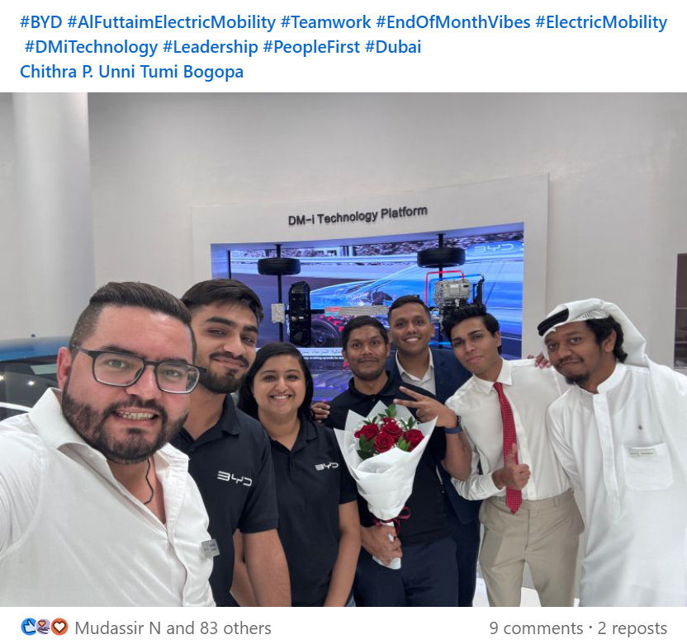
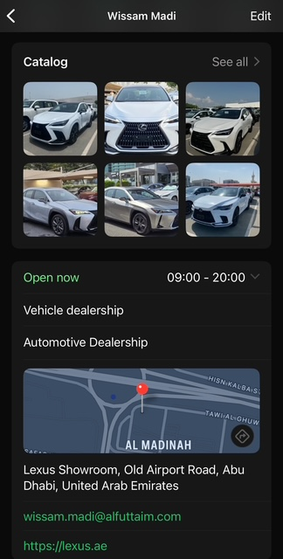
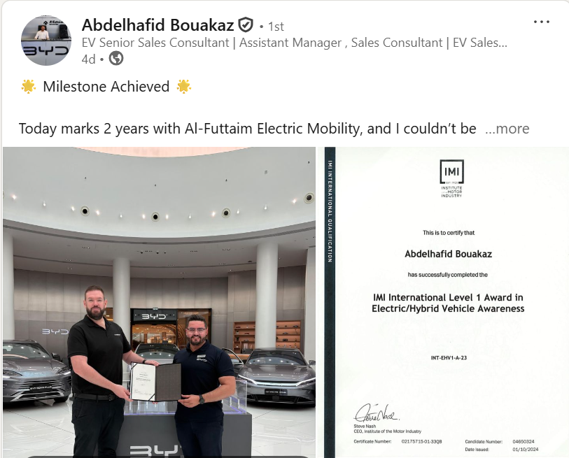
PROFFESIONAL PROMOTION & RECOGNITION
Notes:
There are always ways we can go above and beyond here are some examples of collegues showcasing experiences, latest news, achievements and products via unique and personal channels

Slide 32
WHAT CAN WE LEVERAGE TO SUPPORT CUSTOMER RETENTION?
Reputation
Vehicle Options
Service Schedule
Occasions & Anniversaries
Repeat custom/Buy Back*
Accessories
Extended Warranty
Finance Option*/Term
Event Tickets / VIP access
FAB Credit Card / Blue Rewards

Slide 33


CONCLUSION
In today’s session we have discussed…
Recap of Modules 3 and 4
The difference between a good and a great delivery
The Importance of the delivery process
Importance of maintaining customer relationships
Follow up methods and expectations
Communication best practise

Slide 34
QUESTIONS…

Slide 35
YOUR SALES GROWTH JOURNEY – NEXT STEPS...
First Gear - Sales Induction & Probation
IMI Sales Process Module 1
IMI Sales Process Module 2
Product eLearning
IMI Sales Process Module 3 (Half day)
On the job training
Advanced Customer Communications
Coaching 1-2-1’s
IMI Sales Accreditation Assessment (In-Branch)
IMI Sales Accreditation Awards Ceremony

Slide 36
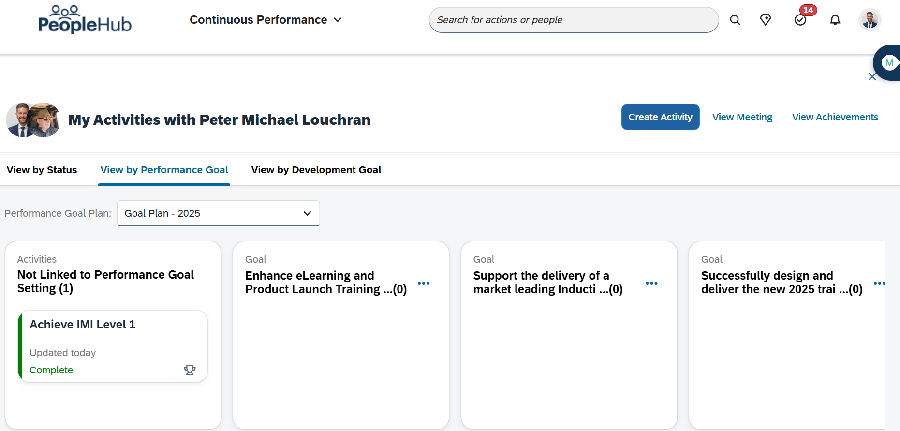
HAVE YOU UPDATED YOUR IDP?

Slide 37
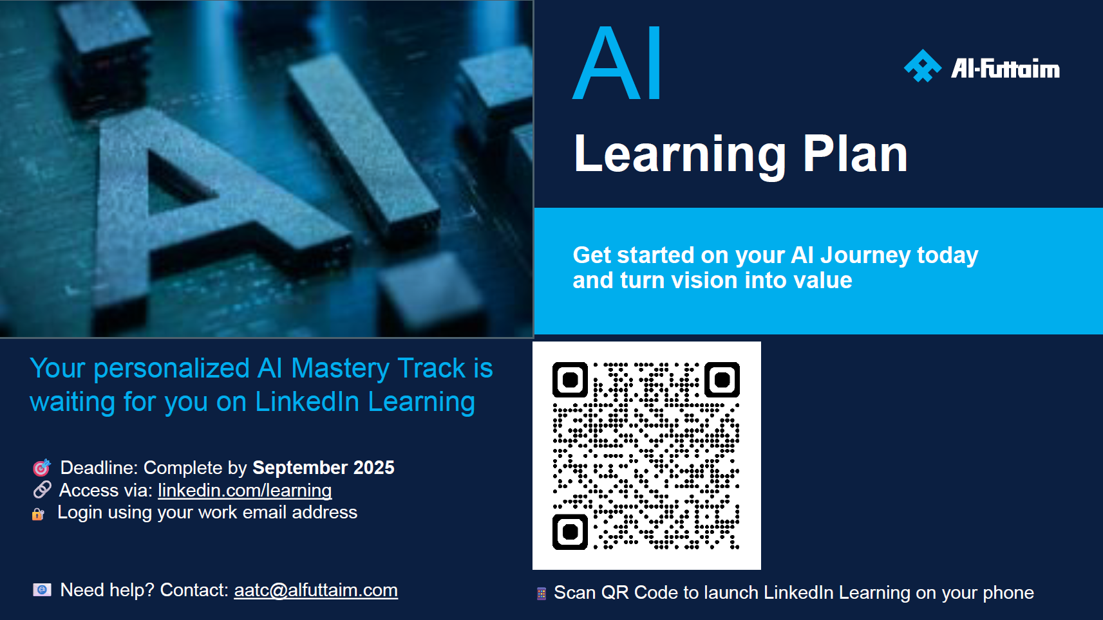
HAVE YOU BECOME AN AI MASTER?
Notes:
Tell: Trainer to signpost and highlight the access and benefits of engaging and completing the AI Learning Plan and link this to previous IDP discussion.

Slide 38
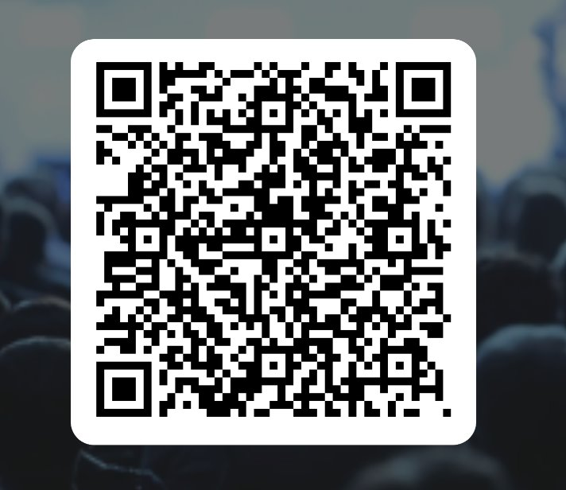
THANK YOU!
Sales Process Module 3 | FEEDBACK
Please scan the QR code below to share your feedback

